Slide 1










Slide 2

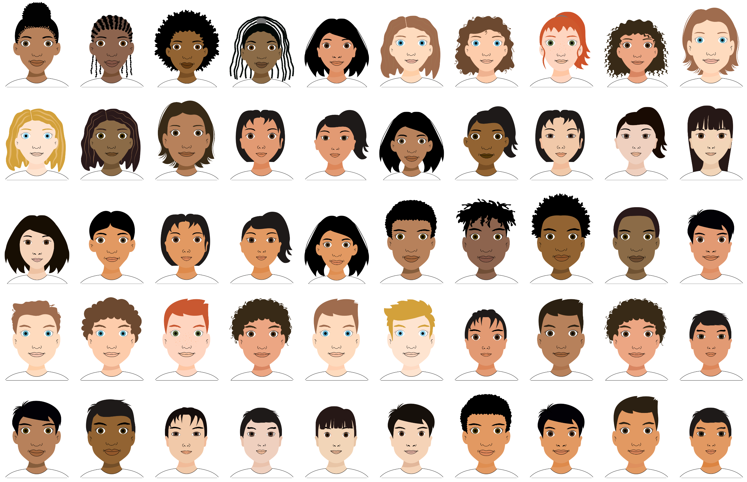



Languages (alphabetically)
Bemba (Zambia)
Chinese (China)
English (India)
English (New Zealand)
English (Nigeria)
English (UK)
English (USA)
German (Germany)
Hai||om (Namibia)
Khewdam (Namibia)
Lingala (Rep. Congo)
Marathi (India)
Shona (Zimbabwe)
Spanish (Argentina)
Spanish (Mexico)
Swahili (Uganda)
Turkish (Türkiye)
Yaka (Rep. Congo)
Number of Trials
Training 1
Training 2
Test
Backgrounds
Agents

Slide 3
Number of Trials
Training 1
Training 2
Test
Backgrounds
Agents

